Slide 1
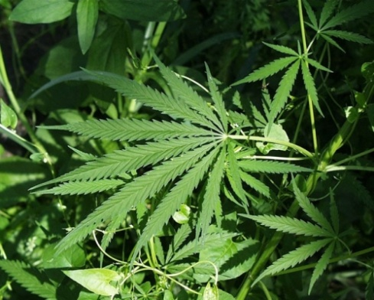
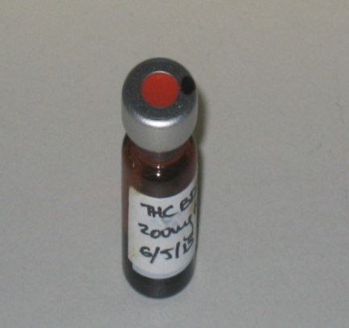
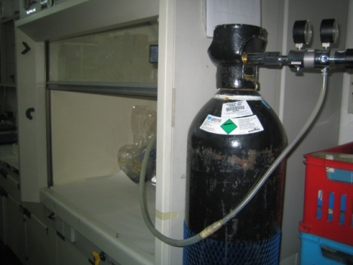
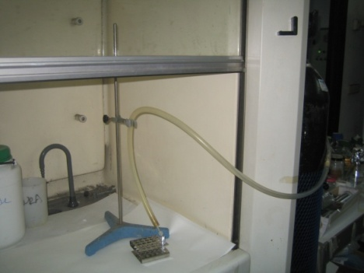
Performing experiments with cannabinoids
1. Cannabinoid compounds (pure THC and CBD or botanical drug substances with controlled amounts of these agents) are used in our experiments and are provided by different Pharmaceutical companies
2. Cannabinoids are provided in vials containing the cannabinoids as a resin diluted in ethanol. These vials are stored at -20ºC.
3. In order to prepare stock solutions of cannabinoids that can be used in in vitro and in vivo experiments, ethanol must be evaporated and the required amount of cannabinoids re-solved in a lipid solvent. During the processing of samples, cannabinoids must be protected from light and exposed to a nitrogen atmosphere as they are photo-sensitive and can get oxidized very easily.

Slide 2
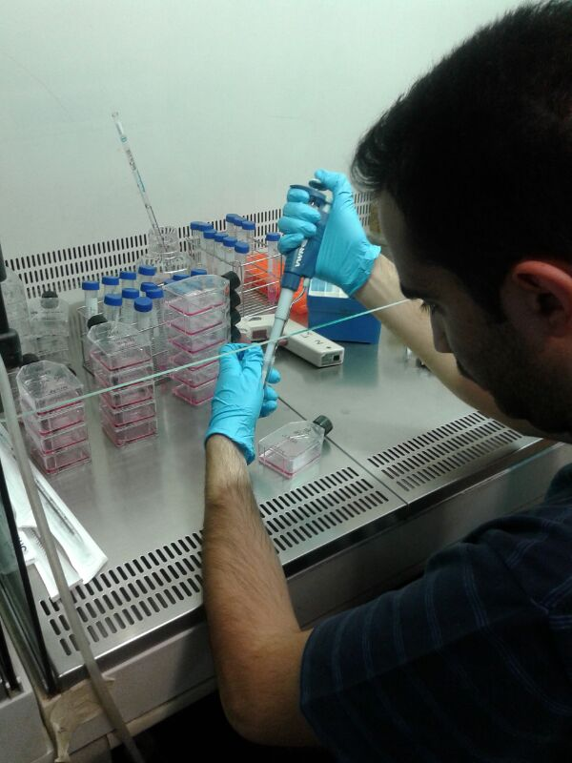
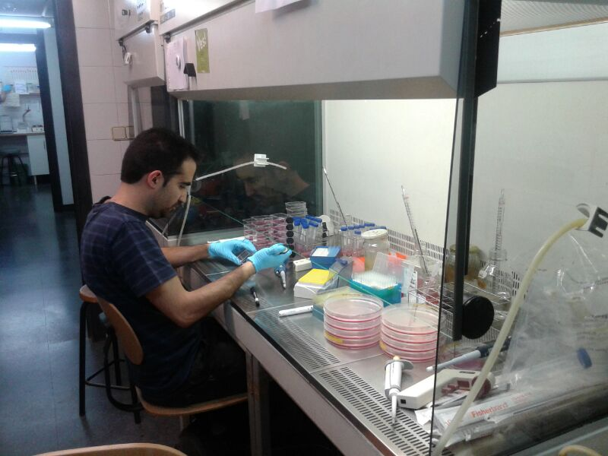
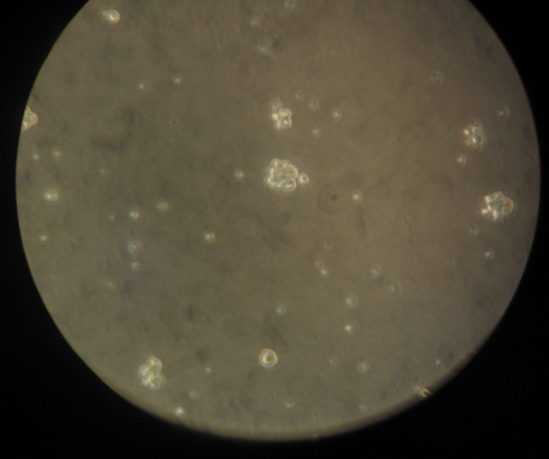
How do we study cannabinoid anticancer activity?
4. One of the strategies that we use to analyze the anticancer activity of cannabinoids is studying the effect of these agents in cultured cancer cells.
Israel López-Valero’s PhD Thesis project is aimed at optimizing the use of cannabinoids as anticancer agents in glioma (Funding kindly provided by Medical Cannabis bike tour is being used to cover the costs of Israel’s contract)
5. Cancer cells are seeded into Flask where we add the drugs at different concentrations. We frequently combine cannabinoids with other anti-cancer agents to produce a better/higher therapeutic effect.
6. One of the cell types in which we are analyzing the effect of cannabinoids in combination with other anticancer agents are the so-called brain-tumor derived cancer initiating cells (GICs). These cells are obtained from brain cancer patients and when cultured form cell aggregates, named neuro-spheres). These cells are believed to be responsible for the resistance of brain tumors to current anticancer therapies.

Slide 3
Cannabinoids can kill cancer cells
7. Here we show a representation of the results obtained in experiments performed in the lab with GICs thanks to the support of MC Biketour
Fold increase (regarding initial numer of cells)
Glioma Initiating cells
No treatment
THC + CBD (low doses)
Anticancer agent (low doses)
Cannabinoid + anticancer agent (low doses)
Passages
The combination of cannabinoids and other anticancer agents kills Glioma initiating cells in vitro.
GICs are dissociated, counted and seeded at low cell density. After 5 days of incubation with cannabinoids and other compounds (P1), neurospheres are dissociated and total cells counted. Next, equal numbers of cells are re-plated at initial density and treated during 5 more days (P2). The figure shows that the combined treatment with cannabinoids and other anticancer agents (green line) eliminates the population of GICs.

Slide 4
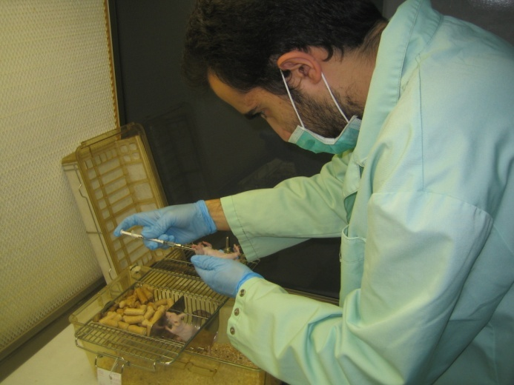
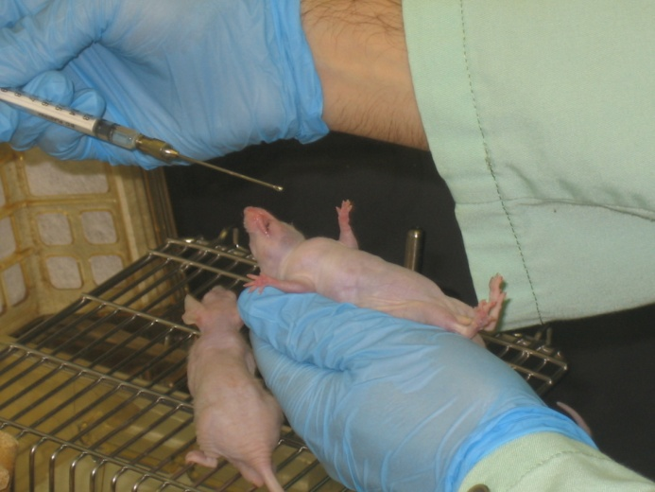
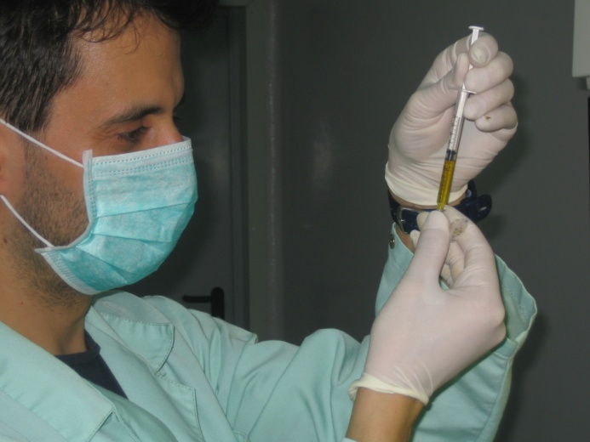
How do we study cannabinoid anticancer activity?
7. After confirming in vitro results we try to reproduce these experiments in vivo, treating the animals with the same combination of cannabinoids and other anticancer agents. To this aim, tumors are generated by intracranial injection of GICs. Once the tumors have reached a certain volume animals are treated with different drugs, including cannabinoids and tumor growth and animal survival are analized.
Israel López Valero and David Dávila (a postdoc who is also working in the project) administer cannabinoids orally (using a gavage) to animals in which brain tumors have been generated.

